Slide 1
Artificial Intelligence

Slide 2
Course Learning Outcomes
At the end of this course:
Knowledge and understanding You should have a knowledge and understanding of the basic concepts of Artificial Intelligence including Search, Game Playing, KBS (including Uncertainty), Planning and Machine Learning.
Intellectual skills You should be able to use this knowledge and understanding of appropriate principles and guidelines to synthesise solutions to tasks in AI and to critically evaluate alternatives.
Practical skills You should be able to use a well known declarative language (Prolog) and to construct simple AI systems.
Transferable Skills You should be able to solve problems and evaluate outcomes and alternatives

Slide 3
Areas of AI and Some Dependencies
Knowledge Representation
Search
Logic
Machine Learning
Planning
Expert Systems
NLP
Vision
Robotics

Slide 4
What is Artificial Intelligence ?
making computers that think?
the automation of activities we associate with human thinking, like decision making, learning ... ?
the art of creating machines that perform functions that require intelligence when performed by people ?
the study of mental faculties through the use of computational models ?

Slide 5
What is Artificial Intelligence ?
the study of computations that make it possible to perceive, reason and act ?
a field of study that seeks to explain and emulate intelligent behaviour in terms of computational processes ?
a branch of computer science that is concerned with the automation of intelligent behaviour ?
anything in Computing Science that we don't yet know how to do properly ? (!)

Slide 6
What is Artificial Intelligence ?
THOUGHT
Systems that think like humans
Systems that think rationally
Systems that act like humans
Systems that act rationally
BEHAVIOUR
HUMAN
RATIONAL

Slide 7
Systems that act like humans: Turing Test
“The art of creating machines that perform functions that require intelligence when performed by people.” (Kurzweil)
“The study of how to make computers do things at which, at the moment, people are better.” (Rich and Knight)

Slide 8
Systems that act like humans
?
You enter a room which has a computer terminal. You have a fixed period of time to type what you want into the terminal, and study the replies. At the other end of the line is either a human being or a computer system.
If it is a computer system, and at the end of the period you cannot reliably determine whether it is a system or a human, then the system is deemed to be intelligent.

Slide 9
Systems that act like humans
The Turing Test approach
a human questioner cannot tell if
there is a computer or a human answering his question, via teletype (remote communication)
The computer must behave intelligently
Intelligent behavior
to achieve human-level performance in all cognitive tasks

Slide 10
Systems that act like humans
These cognitive tasks include:
Natural language processing
for communication with human
Knowledge representation
to store information effectively & efficiently
Automated reasoning
to retrieve & answer questions using the stored information
Machine learning
to adapt to new circumstances

Slide 11
The total Turing Test
Includes two more issues:
Computer vision
to perceive objects (seeing)
Robotics
to move objects (acting)

Slide 12
What is Artificial Intelligence ?
THOUGHT
Systems that think like humans
Systems that think rationally
Systems that act like humans
Systems that act rationally
BEHAVIOUR
HUMAN
RATIONAL

Slide 13
Systems that think like humans: cognitive modeling
Humans as observed from ‘inside’
How do we know how humans think?
Introspection vs. psychological experiments
Cognitive Science
“The exciting new effort to make computers think … machines with minds in the full and literal sense” (Haugeland)
“[The automation of] activities that we associate with human thinking, activities such as decision-making, problem solving, learning …” (Bellman)

Slide 14
What is Artificial Intelligence ?
THOUGHT
Systems that think like humans
Systems that think rationally
Systems that act like humans
Systems that act rationally
BEHAVIOUR
HUMAN
RATIONAL

Slide 15
Systems that think ‘rationally’ "laws of thought"
Humans are not always ‘rational’
Rational - defined in terms of logic?
Logic can’t express everything (e.g. uncertainty)
Logical approach is often not feasible in terms of computation time (needs ‘guidance’)
“The study of mental facilities through the use of computational models” (Charniak and McDermott)
“The study of the computations that make it possible to perceive, reason, and act” (Winston)

Slide 16
What is Artificial Intelligence ?
THOUGHT
Systems that think like humans
Systems that think rationally
Systems that act like humans
Systems that act rationally
BEHAVIOUR
HUMAN
RATIONAL

Slide 17
Systems that act rationally: “Rational agent”
Rational behavior: doing the right thing
The right thing: that which is expected to maximize goal achievement, given the available information
Giving answers to questions is ‘acting’.
I don't care whether a system:
replicates human thought processes
makes the same decisions as humans
uses purely logical reasoning

Slide 18
Systems that act rationally
Logic → only part of a rational agent, not all of rationality
Sometimes logic cannot reason a correct conclusion
At that time, some specific (in domain) human knowledge or information is used
Thus, it covers more generally different situations of problems
Compensate the incorrectly reasoned conclusion

Slide 19
Systems that act rationally
Study AI as rational agent –
2 advantages:
It is more general than using logic only
Because: LOGIC + Domain knowledge
It allows extension of the approach with more scientific methodologies

Slide 20
Rational agents
An agent is an entity that perceives and acts
This course is about designing rational agents
Abstractly, an agent is a function from percept histories to actions:
[f: P* → A]
For any given class of environments and tasks, we seek the agent (or class of agents) with the best performance
Caveat: computational limitations make perfect rationality unachievable
→ design best program for given machine resources

Slide 21
Artificial
Produced by human art or effort, rather than originating naturally.
Intelligence
is the ability to acquire knowledge and use it" [Pigford and Baur]
So AI was defined as:
AI is the study of ideas that enable computers to be intelligent.
AI is the part of computer science concerned with design of computer systems that exhibit human intelligence(From the Concise Oxford Dictionary)

Slide 22
From the above two definitions, we can see that AI has two major roles:
Study the intelligent part concerned with humans.
Represent those actions using computers.

Slide 23
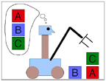
Goals of AI
To make computers more useful by letting them take over dangerous or tedious tasks from human
Understand principles of human intelligence

Slide 24
The Foundation of AI
Philosophy
At that time, the study of human intelligence began with no formal expression
Initiate the idea of mind as a machine and its internal operations

Slide 25
The Foundation of AI
Mathematics formalizes the three main area of AI: computation, logic, and probability
Computation leads to analysis of the problems that can be computed
complexity theory
Probability contributes the “degree of belief” to handle uncertainty in AI
Decision theory combines probability theory and utility theory (bias)

Slide 26
The Foundation of AI
Psychology
How do humans think and act?
The study of human reasoning and acting
Provides reasoning models for AI
Strengthen the ideas
humans and other animals can be considered as information processing machines

Slide 27
The Foundation of AI
Computer Engineering
How to build an efficient computer?
Provides the artifact that makes AI application possible
The power of computer makes computation of large and difficult problems more easily
AI has also contributed its own work to computer science, including: time-sharing, the linked list data type, OOP, etc.

Slide 28
The Foundation of AI
Control theory and Cybernetics
How can artifacts operate under their own control?
The artifacts adjust their actions
To do better for the environment over time
Based on an objective function and feedback from the environment
Not limited only to linear systems but also other problems
as language, vision, and planning, etc.

Slide 29
The Foundation of AI
Linguistics
For understanding natural languages
different approaches has been adopted from the linguistic work
Formal languages
Syntactic and semantic analysis
Knowledge representation

Slide 30
The main topics in AI
Artificial intelligence can be considered under a number of headings:
Search (includes Game Playing).
Representing Knowledge and Reasoning with it.
Planning.
Learning.
Natural language processing.
Expert Systems.
Interacting with the Environment (e.g. Vision, Speech recognition, Robotics)
We won’t have time in this course to consider all of these.

Slide 31
Some Advantages of Artificial Intelligence
more powerful and more useful computers
new and improved interfaces
solving new problems
better handling of information
relieves information overload
conversion of information into knowledge

Slide 32
The Disadvantages
increased costs
difficulty with software development - slow and expensive
few experienced programmers
few practical products have reached the market as yet.

Slide 33
Search
Search is the fundamental technique of AI.
Possible answers, decisions or courses of action are structured into an abstract space, which we then search.
Search is either "blind" or “uninformed":
blind
we move through the space without worrying about what is coming next, but recognising the answer if we see it
informed
we guess what is ahead, and use that information to decide where to look next.
We may want to search for the first answer that satisfies our goal, or we may want to keep searching until we find the best answer.

Slide 34
Knowledge Representation & Reasoning
The second most important concept in AI
If we are going to act rationally in our environment, then we must have some way of describing that environment and drawing inferences from that representation.
how do we describe what we know about the world ?
how do we describe it concisely ?
how do we describe it so that we can get hold of the right piece of knowledge when we need it ?
how do we generate new pieces of knowledge ?
how do we deal with uncertain knowledge ?

Slide 35
Knowledge
Declarative
Procedural
Declarative knowledge deals with factoid questions (what is the capital of India? Etc.)
Procedural knowledge deals with “How”
Procedural knowledge can be embedded in declarative knowledge

Slide 36
Planning
Given a set of goals, construct a sequence of actions that achieves those goals:
often very large search space
but most parts of the world are independent of most other parts
often start with goals and connect them to actions
no necessary connection between order of planning and order of execution
what happens if the world changes as we execute the plan and/or our actions don’t produce the expected results?

Slide 37
Learning
If a system is going to act truly appropriately, then it must be able to change its actions in the light of experience:
how do we generate new facts from old ?
how do we generate new concepts ?
how do we learn to distinguish different situations in new environments ?

Slide 38
Interacting with the Environment
In order to enable intelligent behaviour, we will have to interact with our environment.
Properly intelligent systems may be expected to:
accept sensory input
vision, sound, …
interact with humans
understand language, recognise speech, generate text, speech and graphics, …
modify the environment
robotics

Slide 39
History of AI
AI has a long history
Ancient Greece
Aristotle
Historical Figures Contributed
Ramon Lull
Al Khowarazmi
Leonardo da Vinci
David Hume
George Boole
Charles Babbage
John von Neuman
As old as electronic computers themselves (c1940)

Slide 40
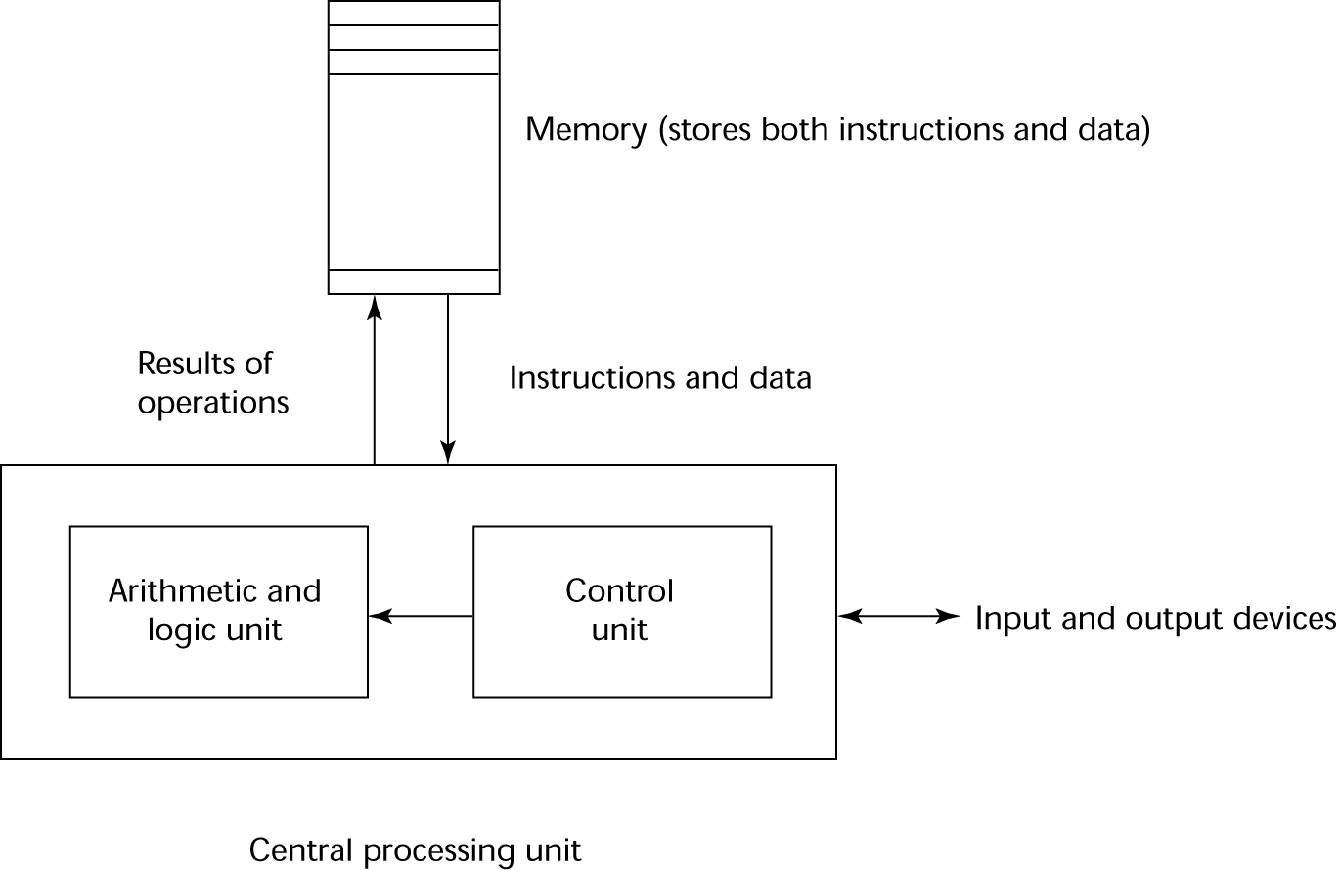
The ‘von Neuman’ Architecture

Slide 41
History of AI
Origins
The Dartmouth conference: 1956
John McCarthy (Stanford)
Marvin Minsky (MIT)
Herbert Simon (CMU)
Allen Newell (CMU)
Arthur Samuel (IBM)
The Turing Test (1950)
“Machines who Think”
By Pamela McCorckindale

Slide 42
Periods in AI
Early period - 1950’s & 60’s
Game playing
brute force (calculate your way out)
Theorem proving
symbol manipulation
Biological models
neural nets
Symbolic application period - 70’s
Early expert systems, use of knowledge
Commercial period - 80’s
boom in knowledge/ rule bases

Slide 43
Periods in AI cont’d
? period - 90’s and New Millenium
Real-world applications, modelling, better evidence, use of theory, ......?
Topics: data mining, formal models, GA’s, fuzzy logic, agents, neural nets, autonomous systems
Applications
visual recognition of traffic
medical diagnosis
directory enquiries
power plant control
automatic cars

Slide 44
Fashions in AI
Progress goes in stages, following funding booms and crises: Some examples:
1. Machine translation of languages
1950’s to 1966 - Syntactic translators
1966 - all US funding cancelled
1980 - commercial translators available
2. Neural Networks
1943 - first AI work by McCulloch & Pitts
1950’s & 60’s - Minsky’s book on “Perceptrons” stops nearly all work on nets
1986 - rediscovery of solutions leads to massive growth in neural nets research
The UK had its own funding freeze in 1973 when the Lighthill report reduced AI work severely -Lesson: Don’t claim too much for your discipline!!!!
Look for similar stop/go effects in fields like genetic algorithms and evolutionary computing. This is a very active modern area dating back to the work of Friedberg in 1958.

Slide 45
Symbolic and Sub-symbolic AI
Symbolic AI is concerned with describing and manipulating our knowledge of the world as explicit symbols, where these symbols have clear relationships to entities in the real world.
Sub-symbolic AI (e.g. neural-nets) is more concerned with obtaining the correct response to an input stimulus without ‘looking inside the box’ to see if parts of the mechanism can be associated with discrete real world objects.
This course is concerned with symbolic AI.

Slide 46
AI Applications
Autonomous Planning & Scheduling:
Autonomous rovers.

Slide 47
AI Applications
Autonomous Planning & Scheduling:
Telescope scheduling

Slide 48
AI Applications
Autonomous Planning & Scheduling:
Analysis of data:

Slide 49
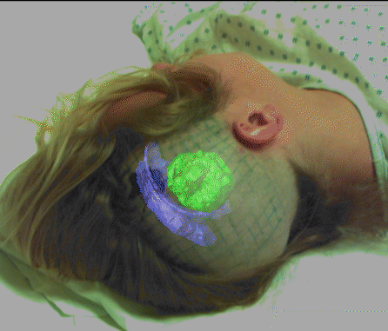
AI Applications
Medicine:
Image guided surgery

Slide 50

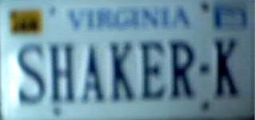

AI Applications
Medicine:
Image analysis and enhancement

Slide 51
AI Applications
Transportation:
Autonomous vehicle control:

Slide 52

AI Applications
Transportation:
Pedestrian detection:

Slide 53
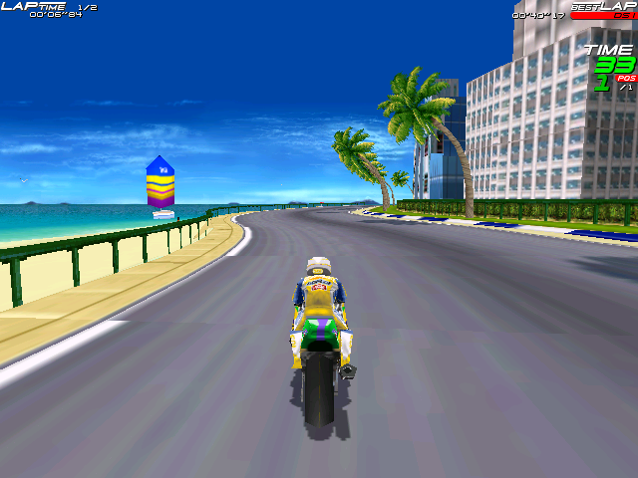
AI Applications
Games:

Slide 54
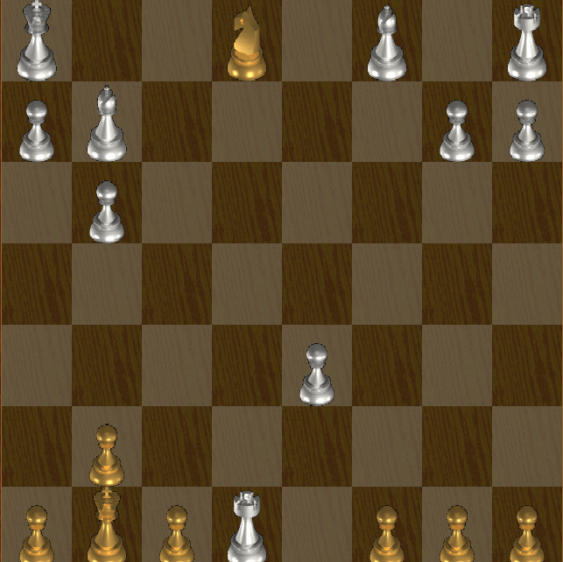
AI Applications
Games:

Slide 55
AI Applications
Robotic toys:

Slide 56
AI Applications
Other application areas:
Bioinformatics:
Gene expression data analysis
Prediction of protein structure
Text classification, document sorting:
Web pages, e-mails
Articles in the news
Video, image classification
Music composition, picture drawing
Natural Language Processing .
Perception.

Slide 57
Homework
Read Pg (1 – 31) From the book

